Slide 1
Comprehensive Digital Marketing Project Work

Slide 2

Project given by

Slide 3
STUDENTS DECLARATION
I ALLA CHANDINI a student of A.M.A.L college program RegNo.120120103006 of the
Department of commerce college do hereby that I have completed. The mandatory internship from 29-05-2023 to 04-08-2023 in DIGITAL MARKETING (name of the intern
organization under the faculty guide ship of SMART BRIDE,(name of the faculty guide),Department of COMMERCE A.M.A.L COLLEGE ANAKAPALLI. (name of the
college.
A.chandini
(signature)

Slide 4
ACKNOWLEDGEMENT
Firstly I would like to Express my indebtedness appreciation "APSCHE" government and Andhra university for providing on excellent opportunity to learn while working through internships. I am grateful to "smart bridge" providing the details of the course in depth and for teaching the topics theoretically and practically to the students kindly smart bridge staff for handling this long-term internship with hard work and patience. I would like to express my sincere thanks to Mr. MANIKALA KONDALA RAO sir, (mentor name), for his/her valuable guidance and support in completing my project. I wish to express my gratitude towards our comprehensive Digital marketing project coordinators “T. Niranjan Kumar Sir”and“J. sambrajyam sir” for their encouragement and problem solving during the project. I extend my gratefulness to our correspondents MR. Dadi. Srinivasa Rao Sir and (Director) K.S.N. Manga Raju sir for their support and heartfelt completing the project. I would also like to express my gratitude towards our(principal) Dr.G. Jayababu Sir for giving me this great opportunity to do a project on BATA (topic name). without their support and suggestions this project would not have been completed.
A.Chandini
(Signature}

Slide 5
TEAM MEMBERS
Team Leader : Batthula yaswanth Team member: Adidam Sai Team member: Alla chandini
Team member: Anakapalli Rupa devi

Slide 6
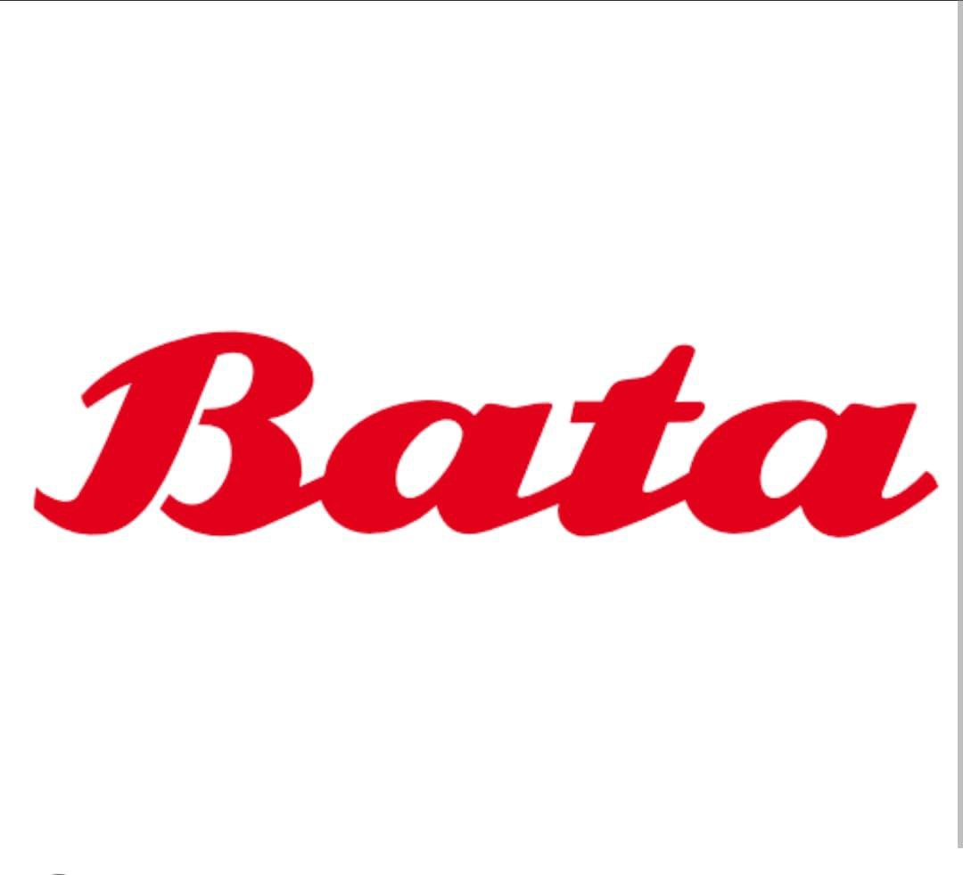

Slide 7
OVERVIEW OF ORGANIZATION
Today, Bata India has established itself as India's largest footwear retailer. Its retail network of over 1375 stores gives it a reach / coverage that no other footwear company can match. The stores are present in good locations and can be found in all the metros, mini-metros and towns.
A family-owned business for over 125 years, the company is organized into three business units: Bata, Bata Industrials (safety shoes) and AW Lab (sports style). Bata is a portfolio company with more than 20 brands and labels, such as Bata, North Star, Power, Bubblegummers, Weinbrenner, Sandak, and Toughees.
Bata India Ltd (Bata India) is a manufacturer, wholesaler, and retailer of footwear and related accessories. The company's product portfolio comprises slippers, sandals, formal wear shoes, casual wear shoes, infant shoes, and sports shoes.

Slide 8

Part 1: Brand study, Competitor Analysis & Buyer’s/Audience’s Persona
Research Brand Identity: Study the brand's mission, values, vision, and unique selling propositions (USPs). :
Company/Topic for project : BATA IND LTD
Brand Colours : red,white
Logo :
Mission:BATA delivers safe, high-quality, efficient, and reliable transportation services in its region that link people, jobs, and communities.
Values: Integrity — Honesty is the key to strong and effective communication between
employees and riders.
Respect — A mutual respect between employer, employees, and community members helps strengthen and grow BATA as an organization

Slide 9
Accountability — Integrity & respect lead to accountability, an important aspect of our organization
Community — When it comes down to it, BATA is community-driven—we want to be the
best we can be for community members who live, work & play in northern Michigan.
U.S.P : Bata brands offers innovation and trust Founder of The company :Tomas Bata
Founded year :September 21, 1894 Official website : https://www.bata.in/

Slide 10
Part 1:Brand study,competitior Analysis & Buyers/Audiences persona
Analyse Brand Messaging : Bata brand known for well-made and well-priced footwear, clothing and accessories, was founded in 1894 in Zlín, Moravia by Tomáš Baťa, his brother Antonín and his sister Anna. Its headquarters is located in Lausanne, Switzerland. Bata succeeded in becoming one of Europe’s leading shoe manufacturers in just a few decades, due to smart enterpenurship and competitive pricing.
Since then, Bata Industrials has evolved to become a designer, producer, and marketer of safety footwear and socks, targeting the professional end user markets. At present, Bata Industrials is one of the world’s largest manufacturers of this type of footwear. It operates four business units worldwide- Bata Europe, Bata Emerging Markets, Bata Branded Business and Bata North America
Examine the Brands Tagline : From a one-man cobblers' operation in 1894, the Bata Shoe Company has grown to became one of the world's leading shoe manufacturing and retailing companies, with a retail network spanning across more than 70 countries. At the forefront of innovation since its inception, not only in the production and design of new styles, but in the creation of business models that permit a quick response to rapidly changing markets

Slide 11
Part 1: Brand study, Competitor Analysis & Buyer’s/Audience’s Persona
Buyer's/Audience's Persona: Clearly define the target audience for the chosen brand. Consider
demographics, psychographics, behaviors and interests.
Target Audience :
Bata is ready to meet any footwear need through its wide range of footwear. If upper-class, high- income individuals desire a luxurious shoe, Bata can meet their needs. If a lower-class, low-income person only needs a shoe to cover their feet, Bata provides a solution for them as well…
Residential consumers :We provide the world's most comfortable and stylish shoes, accessories and
apparel to help consumers look and feel their best. We know we've done our job when ...

Slide 12
Commercial and industrial customers :The Bata Group is a family-owned business, making it possible to provide customers around the world with the best shoes at the best prices, ...
Quality and Trust :There are five traits that you'll find within data quality: accuracy, completeness, reliability,
relevance, and timeliness – read on to learn more.
A data trust is a secure system and legal entity that manages someone's data on their behalf. Often an independent third party, they store the data and manage individual and collective rights of submission and access to data….

Slide 13
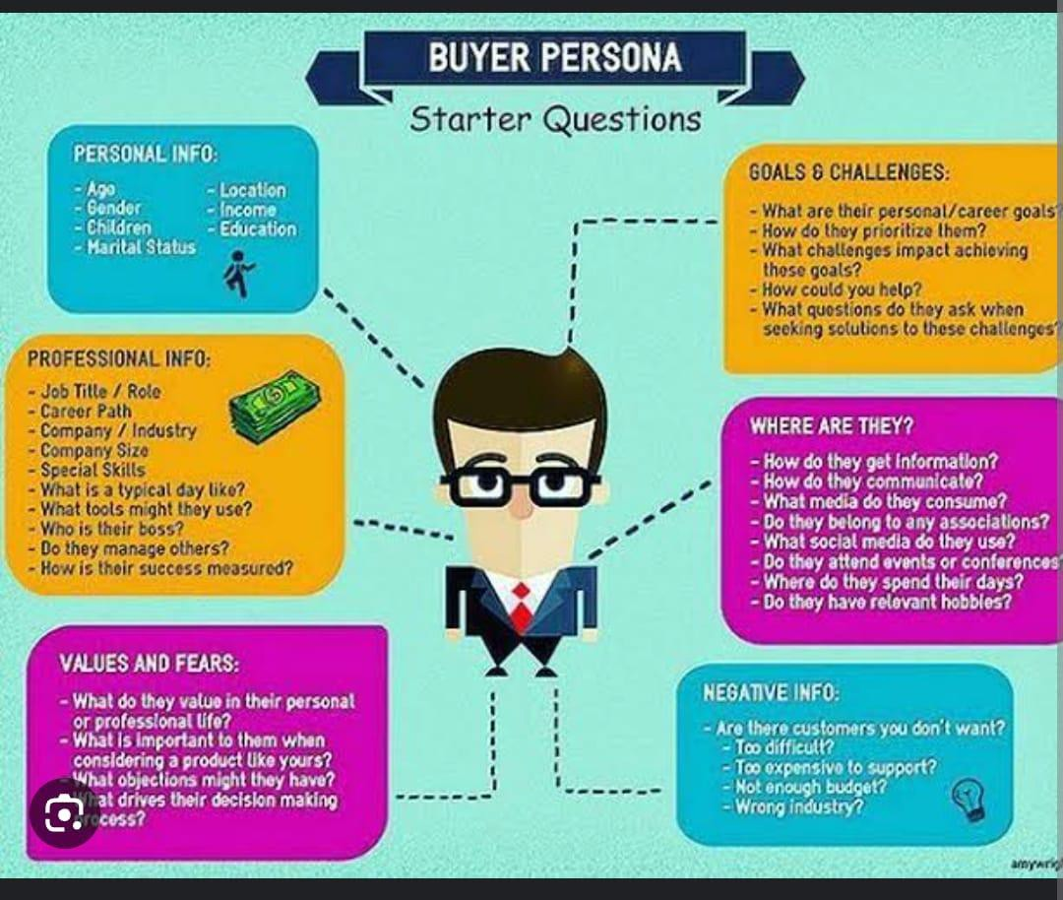
Bata
Boy and girls Age :3-50Years Bata have almost Branches all over of
India.
Ads :You Tube Instagram Community Platform Like google.
Social status :persons Experience long lasting Price.

Slide 14
Part 1: Brand study, Competitor Analysis & Buyer’s/Audience’s Persona
Competitor Analysis: Select three competitors operating in the same industry or
niche as the chosen brand, examine their USPs and online communication.
Competitor 1:https://www.bata.in/brands/
u.s.p : The Paragon Banking Group PLC is one of the United Kingdom's largest providers
of mortgages, savings accounts, and business finance.
Communication: Paragon Communications Inc. is a market leader in remanufactured electronics, managed services.
Competitor 2:https://www.woodlandworldwide.com
u.s.p : Every customer looks for a reason why he should choose that specific product and not the others lying on the same shelf.

Slide 15
Communication : Woodlands Communications provides digital communication, public relation, strategic planning, social media, and change management service.
Competitior 3 : https://www.reebok.in/
u.s.p : The company is known for its innovative and comfortable footwear and sports apparel.
Communication : this reported is presented with intent to draw would the comparsion in the marketing communication strategies and mix adopted by the shoes brands and reebok.

Slide 16
Part 2: SEO & Keyword Research
SEO Audit: Now that you’ve learned how to show up in search results, let’s determine which strategic keywords to target in your website’s content, and how to craft that content to satisfy both users and search engines. The power of keyword research lies in better understanding your target market and how they are searching for your content, services, or products. In this chapter, you’ll get tools and strategies for uncovering that
information, as well as learn tactics that’ll help you avoid keyword research foibles and build strong content. Once you uncover how your target audience is searching for your content, you begin to uncover a whole new world of strategic SEO!
Keyword Research: Keyword research is a practice search engine optimization professionals used to find and research search terms that users enter into search engines when looking for products, services, or general information keywords are related to queries that are asked by users in search engines.
On page Optimization: refers to all measures taken by SEOs within the website to improve the ranking of a site in search engineer result pages. These measures are related to content and HTML source code of a page, e.g., meta tags, keyword Exc

Slide 17
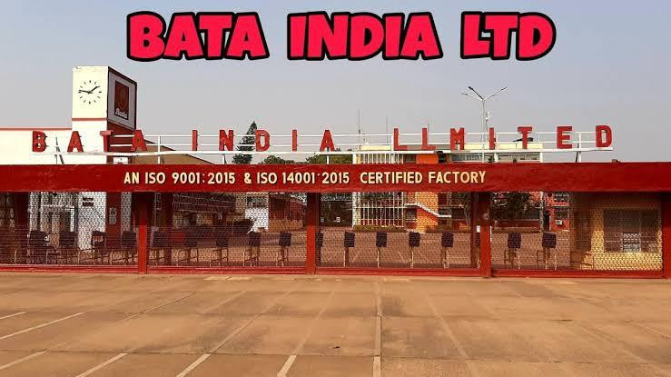
Bata : Incorporated as Bata Shoe Company Private Limited in 1931, the company was set up initially as a small operation in Konnagar (near Calcutta) in 1932. In January 1934, the foundation stone for the first building of Bata’s operation - now called the Bata. In the years that followed, the overall site was doubled in area. This township is popularly known as Batanagar. It was also the first manufacturing facility in the Indian shoe industry to receive the ISO: 9001 certification.
The Company went public in 1973 when it changed its name to Bata India Limited. Today, Bata India has established itself as India’s largest footwear retailer. Its retail network of over 1375 stores gives it a reach / coverage that no other footwear company can match. The stores are present in good locations and can be found in all the metros, mini-metros and towns.

Slide 18
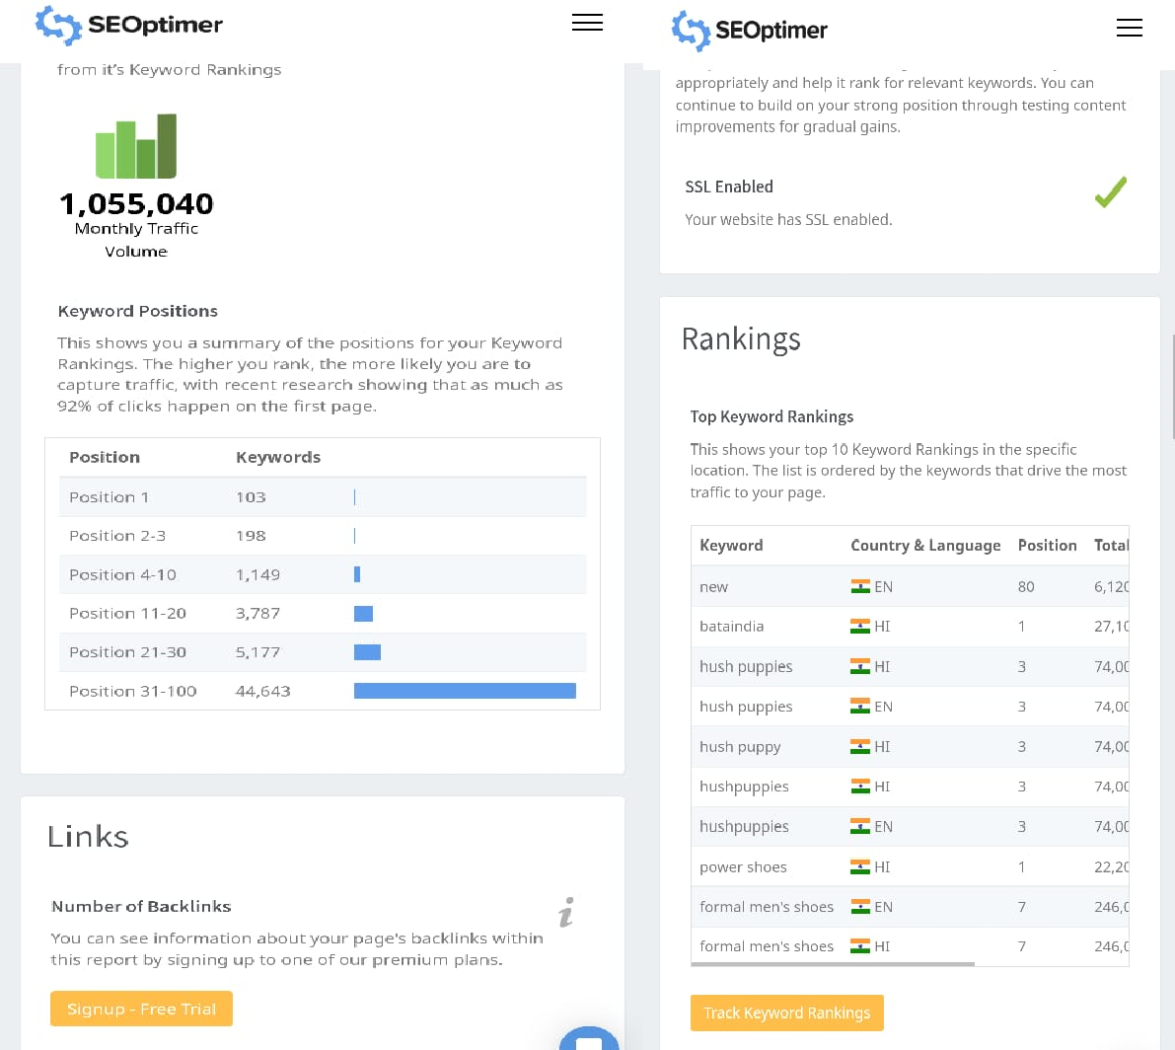
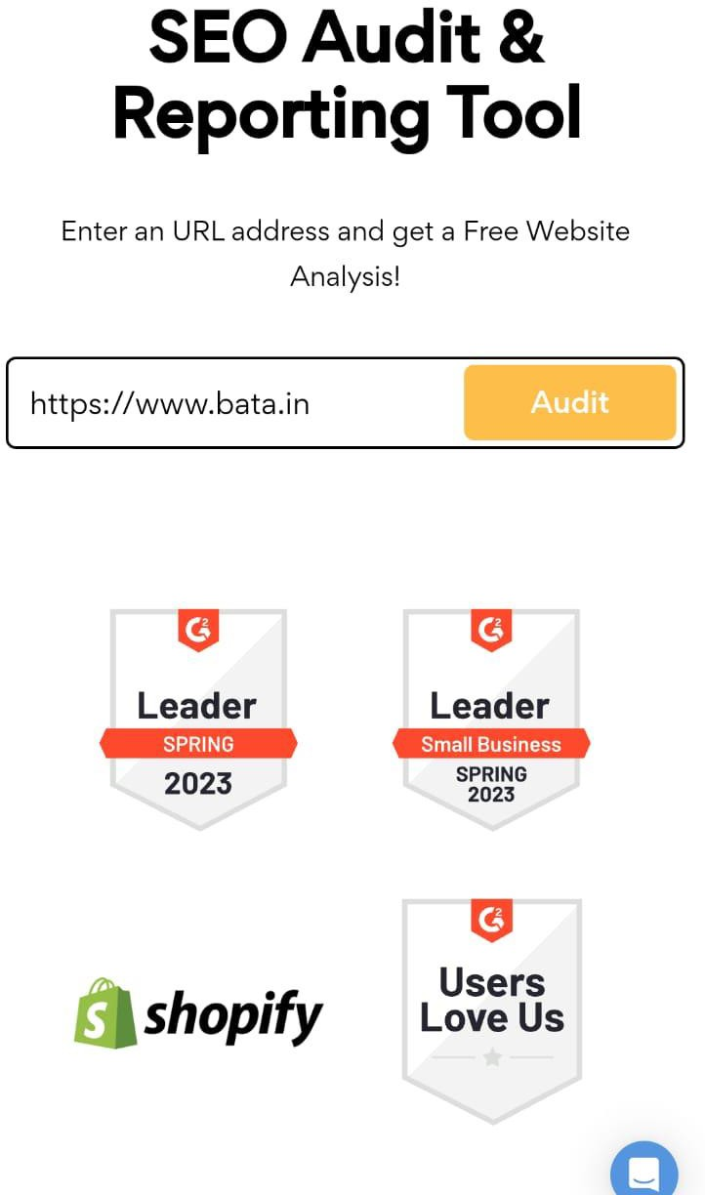

Slide 19
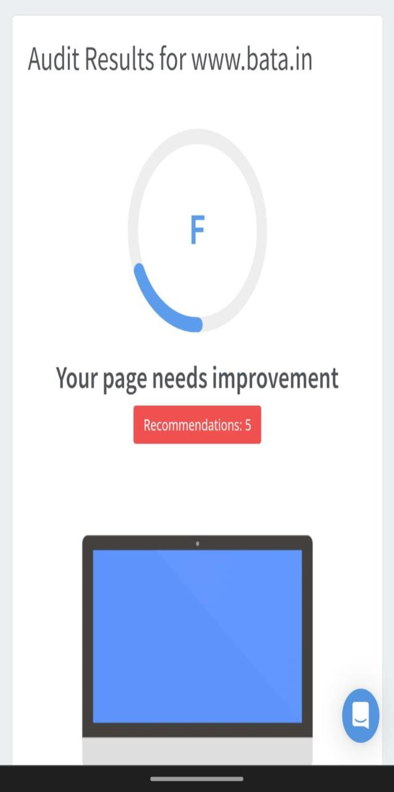
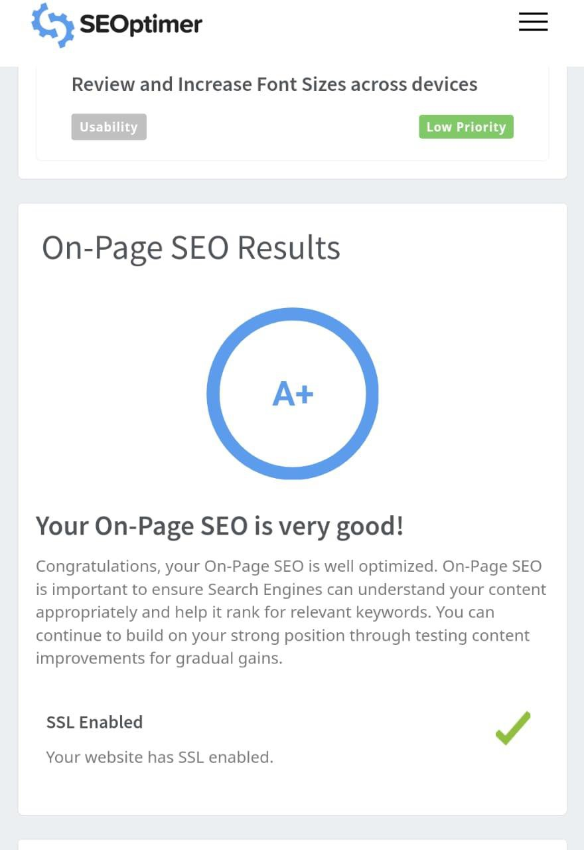
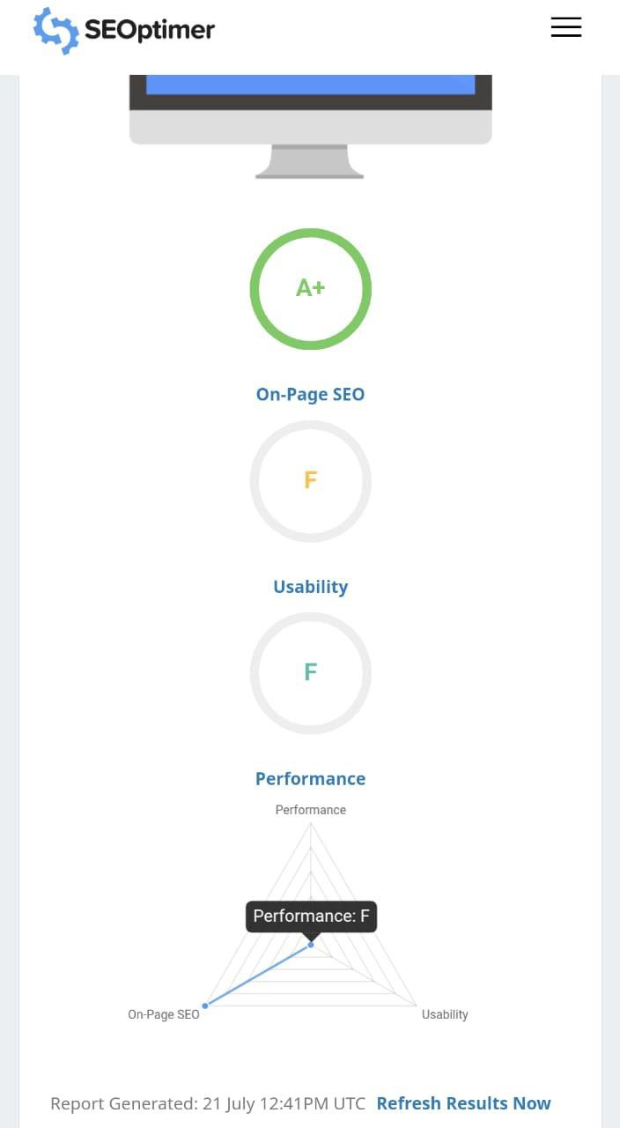

Slide 20
Part 3: Content Ideas and Marketing Strategies
Content Idea Generation & Strategy: Create a content calendar for the remaining month of July by brainstorming content themes, exploring various formats like blog posts, videos, infographics, podcasts, and interactive quizzes, and scheduling publication dates mainly on Facebook & Instagram.
And include the strategy, aim and the idea behind these posts and story
Content Calendar Example (Try creating a table for the month of July)
product strategy : Bata is one of the most popular brands in the shoe industry having a wide variety of footwear for all age groups. The main products in its marketing mix are general category of casual shoes, formal shoes, sandals, kids’ shoes, men and women collection, sports shoes etc. The product line gets upgraded with time and new fashion in market. Bata has specially known for its brand value and quality product.

Slide 21
Pricing strategy: Bata is one of the most popular brands in the shoe industry having a wide variety of footwear for all age groups. The main products in its marketing mix are general category of casual shoes, formal shoes, sandals, kids’ shoes, men and women collection, sports shoes etc. The product line gets upgraded with time and new fashion in market. Bata has specially known for its brand value and quality product.
Place & Distribution strategy : Bata is one of the most popular brands in the shoe industry having a wide variety of footwear for all age groups. The main products in its marketing mix are general category of casual shoes, formal shoes, sandals, kids’ shoes, men and women collection, sports shoes etc. The product line gets upgraded with time and new fashion in market. Bata has specially known for its brand value and quality product.
Promotional & Advertising strategy : Seasonal Sales, discounted days are some strategies to grab more attention of customers.Bata have consistently targeted all segments of the market varing its product costing range. Hence for promoting all this, Bata has also followed traditional method for targeting Indian festivals for its discounts..

Slide 22
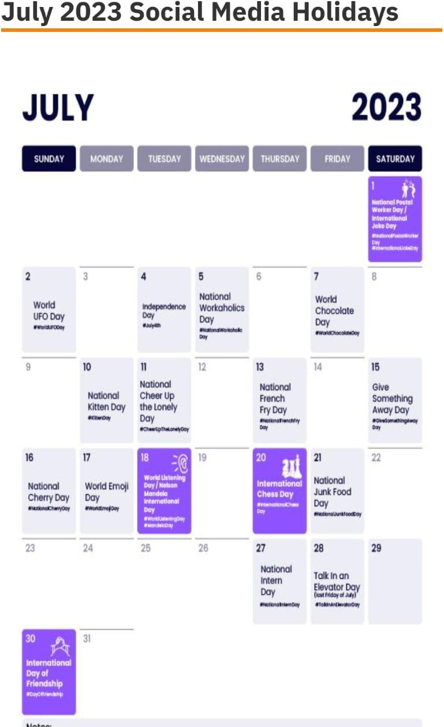

Slide 23
Part 3: Content Ideas and Marketing Strategies
Reflect on the content ideas and marketing strategies process, discussing the challenges encountered and lessons learned.
Repurpose your existing content.
Make an expert roundup.
Craft some holiday content.
Start a podcast.
Create actionable content that gives instructions about how to use your product .
Create content on the best practices for your industry.
Write guides that break down different topics in your industry.
Write a case study.
Marketing strategy process :The strategic marketing process involves conducting research and establishing goals and objectives that will maximize the effectiveness and success of your overall marketing strategy .this process is beneficial as it helps you be more intentional with your marketing.

Slide 24
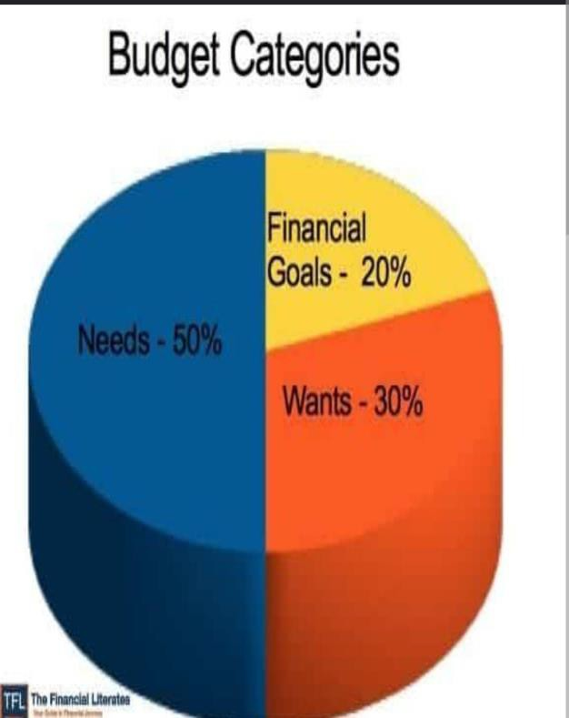
Recruting Talent: At Bata, we're focused on making beautiful, comfortable and affordable ... This level of service requires attention to detail, excellent listening skills, ...
Maintaining a sufficient budget : Calculate your net income. The foundation of an
effective budget is your net income.Track your spending. Set realistic goals. Make a plan. your spending to saty on budget.

Slide 25
Part 4: Content Creation and Curation (Post creations, Designs/Video Editing, Ad Campaigns over Social Media and Email Ideation and Creation)
Post Creation:
Select Content Categories: Identify three different content formats relevant to the chosen topic or industry. Research and Brainstorm: Research trending topics, industry news, or audience interests within each category. Brainstorm ideas for social media posts that align with each category. Do note that 1 content format has to be video and additionally 3 stories/status are to be created.
Format 1 Blog article
Format 2 video
Format 3 creative

Slide 26
Format1 :Blog artical
Aim :BATA delivers safe, high-quality, efficient, and reliable transportation services in its region that link people, jobs, and communities.
Idea : When we talk about reliable and durable footwear, one of the brands that come to our mind is Bata. A household name for over a decade, ...
topic : This blog will fully cover Bata India's marketing strategy, STP, marketing campaign, social media
marketing, and SEO strategies.
Formate 2 ; video
Aim : BATA delivers safe, high-quality, efficient, and reliable transportation services in its region that link people, jobs, and communities.
Idea : bata has launched new water proof slippers and shoes and we make tutorial diffirentways
Topic : This blog will fully cover Bata India's marketing strategy, STP, marketing campaign, social media marketing, and SEO strategies

Slide 27
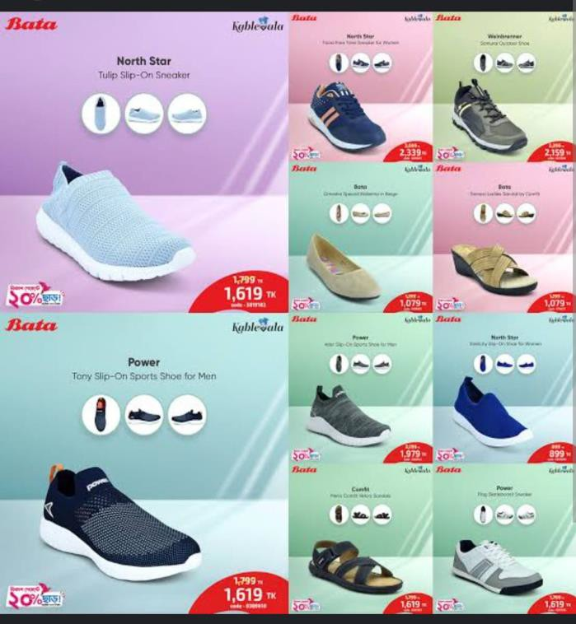
Formate 3 : creative
Aim : Brand awareness and reach idea : to creative a meme on the trending
Topic : kids today will never know the real back to school shoes…

Slide 28
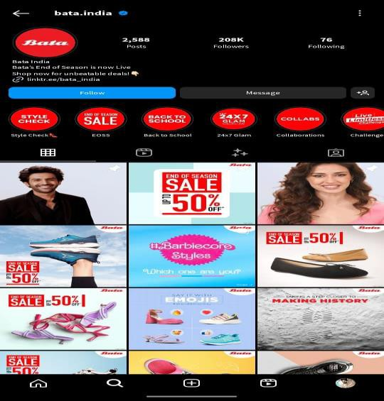
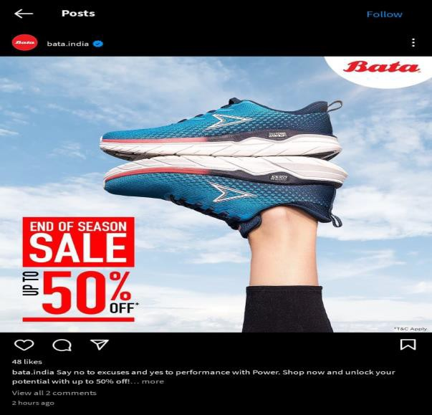
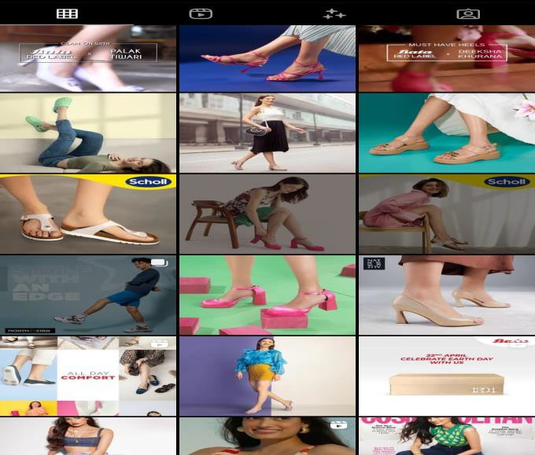
Instagram Story
Part 4: Content Creation and Curation (Post creations, Designs/Video Editing, Ad Campaigns over Social Media and Email Ideation and Creation)
https://www.instagram.com/

Slide 29
Designs/Video Editing
Part 4: Content Creation and Curation (Post creations, Designs/Video Editing, Ad Campaigns over Social Media and Email Ideation and Creation)
Design Tools Familiarization (use Canva for creating visually appealing graphics)
Video Creation: Utilize VN or any video editor of your choice to create videos related to the
chosen topic.

Slide 30
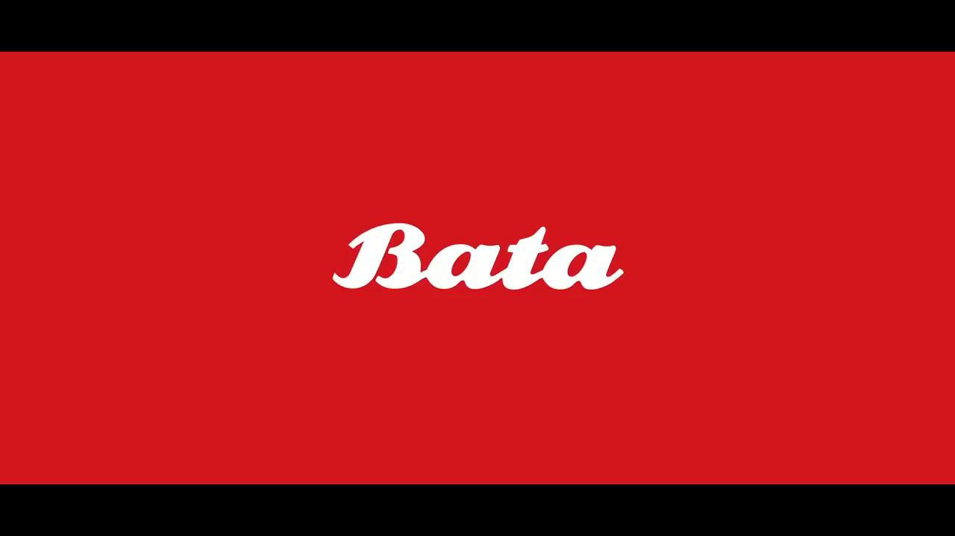

Slide 31
Part 4: Content Creation and Curation (Post creations, Designs/Video Editing, Ad Campaigns over Social Media and Email Ideation and Creation)
Social Media Ad Campaigns
Ad Campaigns over Social Media:
INSTAGRAM AD CAMPAIGN : Instagram ads are posts that promote a business products or services.The post can appear in multiple ways,such as an Instagram feed,stories,or both.they can include images or video along with copy and a link to the web page of the companys choice.

Slide 32
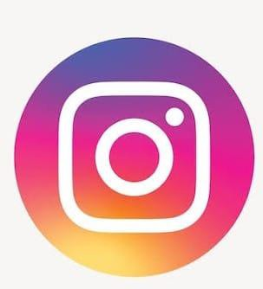
BRAND AWARNESS : Post content that is consistent with your brand personality. The key to increasing your brand awareness via Instagram is consistency. The content you post must be consistent with your overall brand personality. Post images and videos that are in line with the goals of your brand…
Goal
To drive awareness of the extension of the brand. The goal of their Instagram campaign was based on boosting awareness and sales of their tropical flavored ‘Summer Edition’ energy drink for the Australian market…

Slide 33

Facebook social media campaign

Slide 34
Facebook networks and celebrated its sponsorship and commitment to Liverpool FC. As part of the campaign, the brand shared a video message from Liverpool manager Jürgen Clop, to influencers and Liverpool fans.
Key takeaway
Facebook networks can be a very powerful way to engage a captive audience. By sponsoring Liverpool, Carlsberg improved its brand awareness and drove significant traffic to its website. This type of collaboration can be very effective in keeping a brand front of mind long after the campaign ends.
Other successful Facebook campaigns
TVibes Slack
BRAND AWARNESS : Build awareness of your brand and business through ads on Facebook and Instagram today. The awareness objective can help people remember seeing your ads. Try it on your ad. Target The Right Audience. Build Brand Awareness. Promote your App.

Slide 35
BRAND AWARNESS : Build awareness of your brand and business through ads on Facebook and Instagram today. The awareness objective can help people remember seeing your ads. Try it on your ad. Target The Right Audience. Build Brand Awareness. Promote your App.
Other successful Instagram campaigns ;
Barry’s Boot camp Adidas Originals
TWITTER SOCIAL MEDIA CAMPAIGIN :
Twitter is the answer to the question what are you doing now. It always you to creat a text like message of up to 140 characters through a pc or on your phone and send it to your followers. It’s a mix of business and social. You could be a at home communicating what your are doing or in work

Slide 36

Twitter social campaign
BRAND AWEARNESS OF TWITTER :March 2022,about 23%of u.s social media users had heard adout tiwtter in the media, on social media, or in advertising over the past four weeks. Of the 86% who know the brand, that ‘s 27%,meaning at the time of the survey twitter in the united states..

Slide 37
Part 4: Content Creation and Curation (Post creations, Designs/Video Editing, Ad Campaigns over Social Media and Email Ideation and Creation)
For every campaign clearly define:
Advertising Goals:
Brand Awareness: Bata India is the largest retailer and leading manufacturer of footwear in India and is a part of the Bata Shoe Organization. Incorporated as Bata Shoe Company Private Limited in 1931, the company was set up initially as a small operation in Konnagar (near Calcutta) in 1932.
Driving website traffic :
Optimize your images….
Perform a regular SEO Audit… Test it frequently….

Slide 38
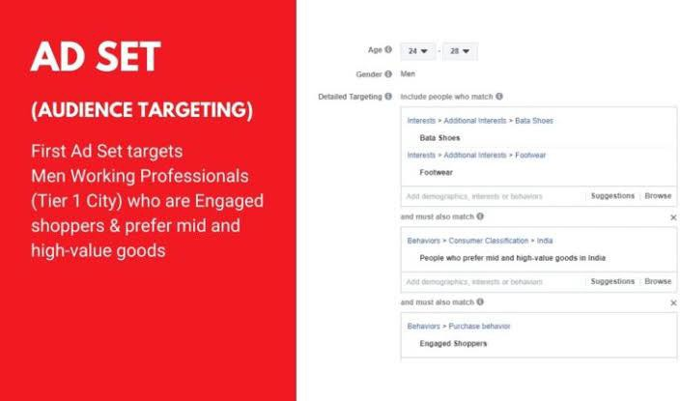
Audience Targeting :
Bata is ready to meet any footwear need through its wide range of footwear.
If upper-class, high-income individuals desire a luxurious shoe, Bata can meet their needs. If a lower-class, low-income person only needs a shoe to cover their feet, Bata provides a solution for them as well….

Slide 39
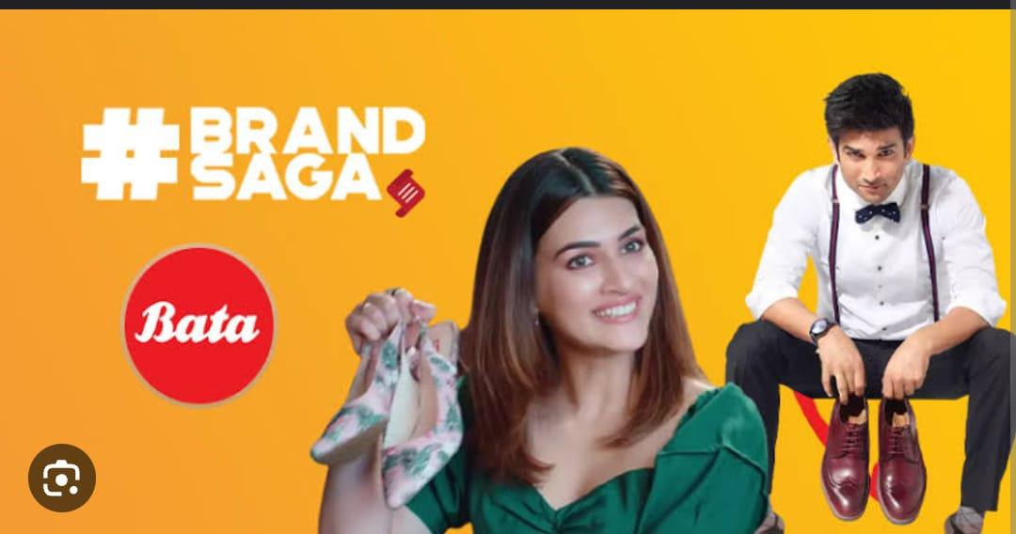
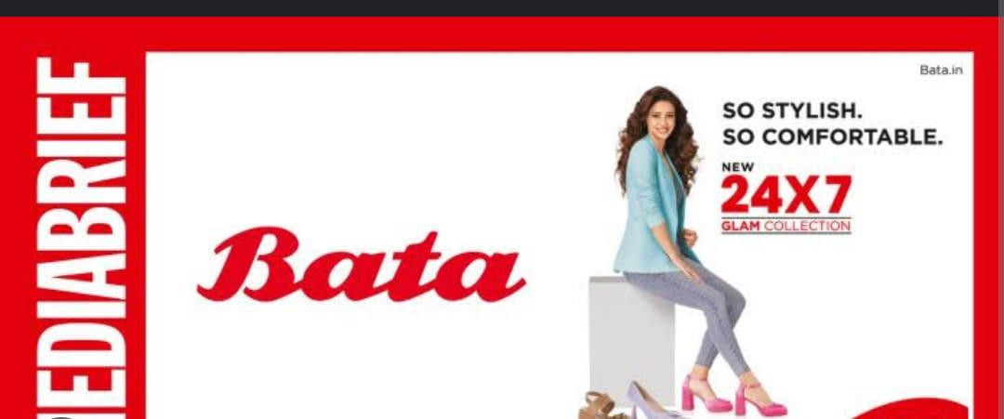
https://www.youtube.com/channel

Slide 40
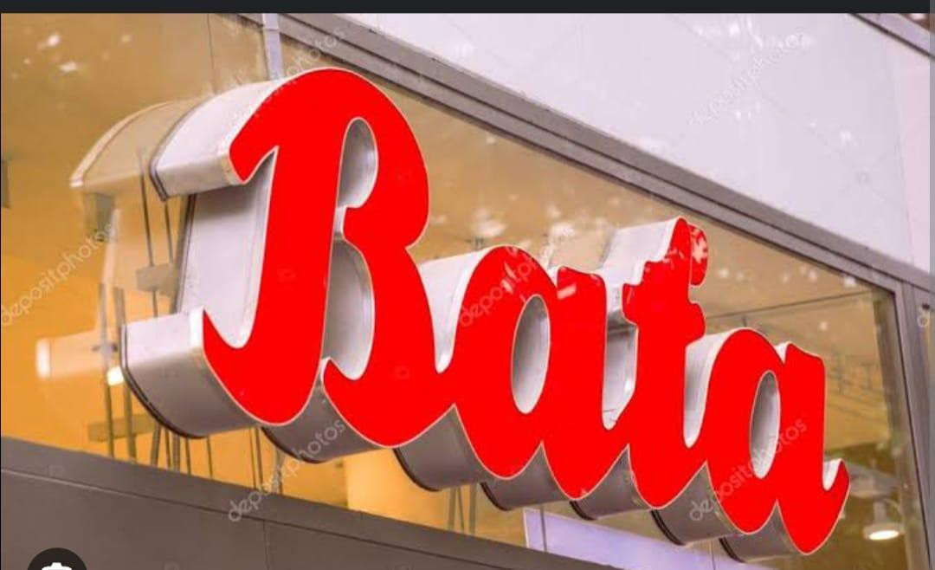
Part 4: Content Creation and Curation (Post creations, Designs/Video Editing, Ad Campaigns over Social Media and Email Ideation and Creation)
Email Ad Campaigns
Ad Campaigns for email marketing:
https://www.passionateinmarketing.com/

Slide 41
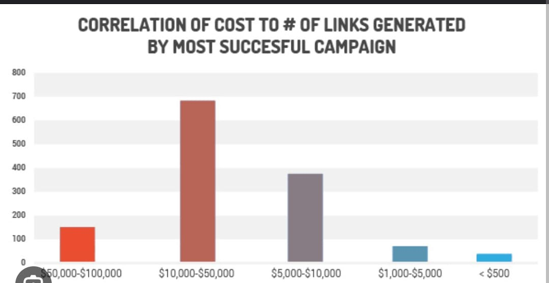
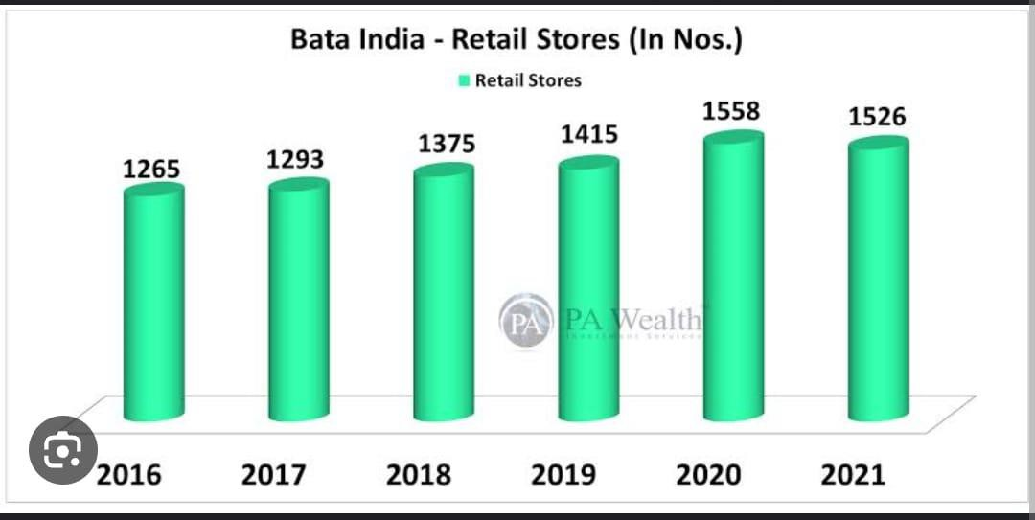
Email Ad Campaign 1 - Brand Awareness
(insert emailer image)

Slide 42
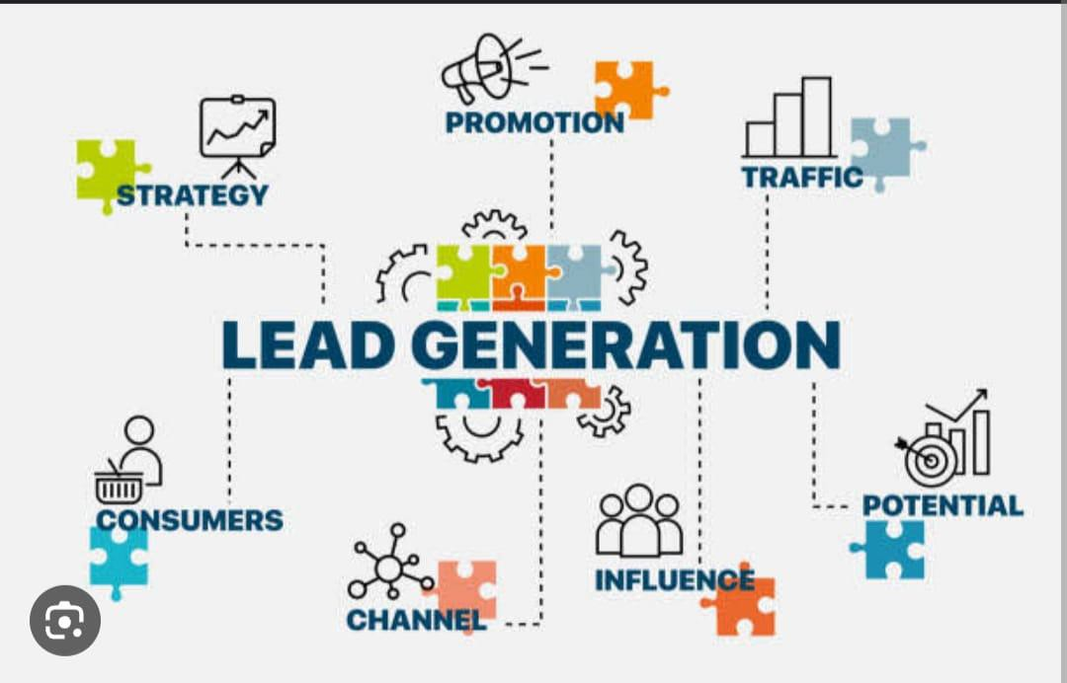
Email Ad Campaign 2 - Lead Generation
(insert emailer image)

Slide 43
Part 4: Content Creation and Curation (Post creations, Designs/Video Editing, Ad Campaigns over Social Media and Email Ideation and Creation)
Reflect on the content creation and curation process, discussing the challenges faced and lessons learned.
We learnt how to create ad campaigns and video designing and gained practical knowledge in
digital marketing.
We gradually learnt how to gain loyal customers and build brand image by attracting target audience.
We convey our sincere regards to our project mentors, tutors & our college staff for their guidance throughout the project.

Slide 44
THANK YOU…

